Slide 1


Using time library

Slide 2
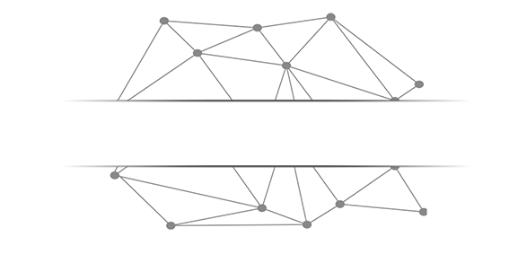
Basic concept of Time library

Slide 3
Time library
time library is the standard library for processing time in Python
- Expression of computer time
import time time.<b>()
- Provides the ability to get the system time and format the output
- Provides system-level precision timing for program performance analysis

Slide 4
Time library
Three types of functions are included in time library
- Getting Time ：time() gmtime() ctime()
Formatting Time ：strftime() strptime()
Timing (Reckon by time) ：sleep(), perf_counter()

Slide 5
Getting Time

Slide 6
Getting Time
function | description
time() | Gets the current timestamp, which is the computer's internal time value, a floating-point number >>>time.time() 1516939876.6022282
ctime() | Gets the current time and represents it in a human-readable manner, returning a string >>>time.ctime() 'Fri Jan 26 12:11:16 2018'

Slide 7
Getting Time
function | description
gmtime() | Gets the current time, expressed as a time format that the computer can handle >>>time.gmtime() time.struct_time(tm_year=2018, tm_mon=1, tm_mday=26, tm_hour=4, tm_min=11, tm_sec=16, tm_wday=4, tm_yday=26, tm_isdst=0)

Slide 8
Formatting Time

Slide 9
Formatting Time
Show the time in a reasonable way
- Formatting: Similar to string formatting, you need to have a display template
- Presentation templates consist of specific formatting controls
- strftime() method

Slide 10
Formatting Time
function | description
strftime(tpl, ts) | tpl is a formatted template string that defines the output effect ts is a computer-internal time type variable >>>t = time.gmtime() >>>time.strftime("%Y-%m-%d %H:%M:%S",t '2018-01-26 12:55:20'
)

Slide 11
Formatting controls
format string | date/time explain | Value ranges and instances
%Y | Year | 0000~9999，e.g.：1900
%m | Month | 01~12，e.g.：10
%B | The Name of Month | January~December，e.g.：April
%b | Month name abbreviation | Jan~Dec，e.g.：Apr
%d | date | 01~31，e.g.：25
%A | What day of the week | Monday~Sunday，e.g.：Wednesday

Slide 12
Formatting controls
format string | date/time explain | Value ranges and instances
%a | Week abbreviation | Mon~Sun，e.g.：Wed
%H | hour（24h system） | 00~23，e.g.：12
%I | hour（12hsystem） | 01~12，e.g.：7
%p | Morning / afternoon | AM, PM，e.g.：PM
%M | minute | 00~59，e.g.：26
%S | second | 00~59，e.g.：26

Slide 13
Formatting Time
>>>t = time.gmtime()
>>>time.strftime("%Y-%m-%d %H:%M:%S",t)
'2018-01-26 12:55:20'
>>>timeStr = '2018-01-26 12:55:20'
>>>time.strptime(timeStr, “%Y-%m-%d %H:%M:%S”)

Slide 14
Formatting Time
function | description
strptime(str, tpl) | Str is a time value as a string TPL is a formatted template string that defines the input effect >>>timeStr = '2018-01-26 12:55:20' >>>time.strptime(timeStr, "%Y-%m-%d %H:%M:%S") time.struct_time(tm_year=2018, tm_mon=1, tm_mday=26, tm_hour=4, tm_min=11, tm_sec=16, tm_wday=4, tm_yday=26, tm_isdst=0)

Slide 15
Timing (Reckon by time)

Slide 16
Timing (Reckon by time)
program timing applied widely
- program timing: Refers to the process of measuring the time elapsed by the start and end action
- measuring time ：perf_counter()
- generation time ：sleep()

Slide 17
program timing
function | description
perf_counter() | Returns an accurate time count value at the CPU level in seconds. Since the starting point of this count value is uncertain, it only makes sense to call the difference in succession >>>start = time.perf_counter() 318.66599499718114 >>>end = time.perf_counter() 341.3905185375658 >>>end - start 22.724523540384666

Slide 18
program timing
function | description
sleep(s) | Parameter s is the time to sleep, in seconds, can be a floating-point number >>>def wait(): time.sleep(3.3) >>>wait() #The program will wait 3.3 seconds before exiting

